Slide 1

Visualization and Analysis –
Tutorial Presentation for Feedback
Date: 11/22/2025
Group Id: A 136 Name of Student Presenting: Aroosha Rasheed

Slide 2
We are using the dataset student_depression_dataset to answer our Research Question
“Is there a difference in the mean student academic score (CGPA) between depressed and non-depressed students in India?”

Slide 3
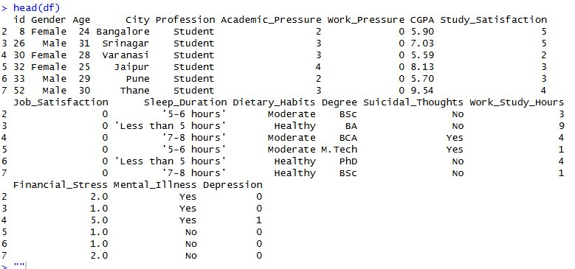
Columns chosen for the visualization:
Academic Score (CGPA) - Dependent Variable​
Depression – Independent Variable​
​
Total Rows: 27,901 and 18 columns​
​
​
​

Slide 4
Part 1: VISUALISATION

Slide 5
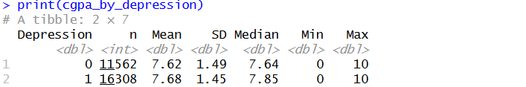
Difference in mean/median CGPA for depressed/non-depressed students in India

Slide 6
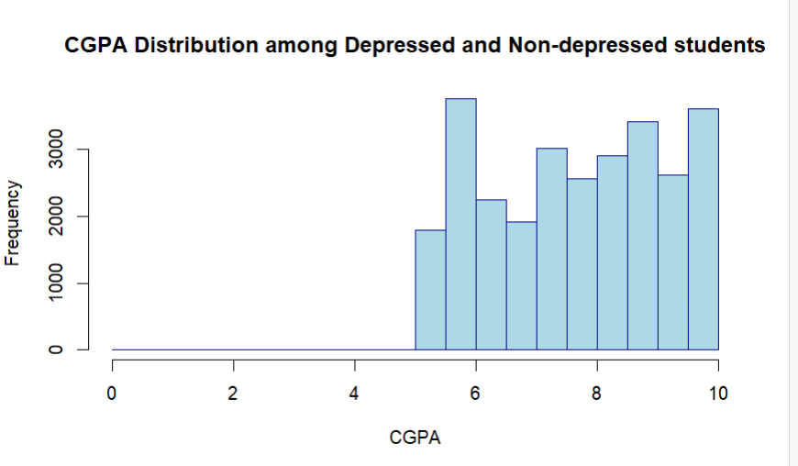
Here is a Histogram showing the frequencies of our dependent variable to include the normal curve overlay (shown in blue).
Our RQ asks about Differences in means/ medians
Overall CGPA
The normal curve overlay does not follow the shape of the underlying data, so we use the non-parametric test that does not assume normality: Wilcoxon also known as the Mann Whitney U Test.
6

Slide 7
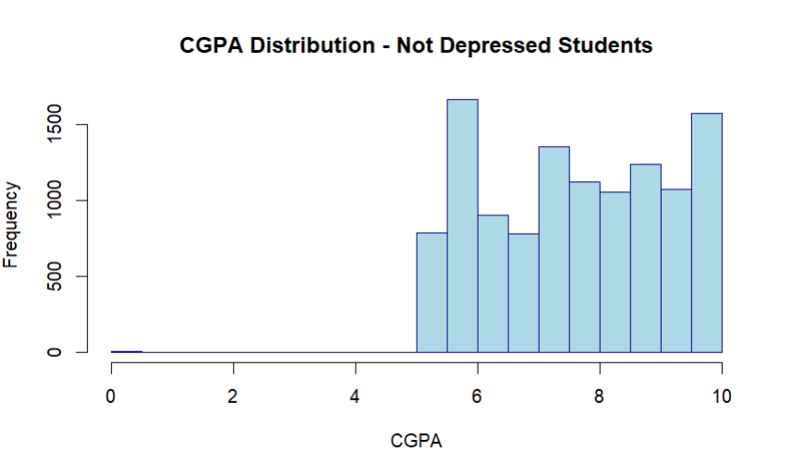
Here is a Histogram showing the frequencies of our dependent variable to include the normal curve overlay (shown in blue).
Our RQ asks about Differences in means/ medians
CGPA of Non-Depressed Students
The normal curve overlay does not follow the shape of the underlying data, so we use the non-parametric test that does not assume normality: Wilcoxon also known as the Mann Whitney U Test.
7

Slide 8
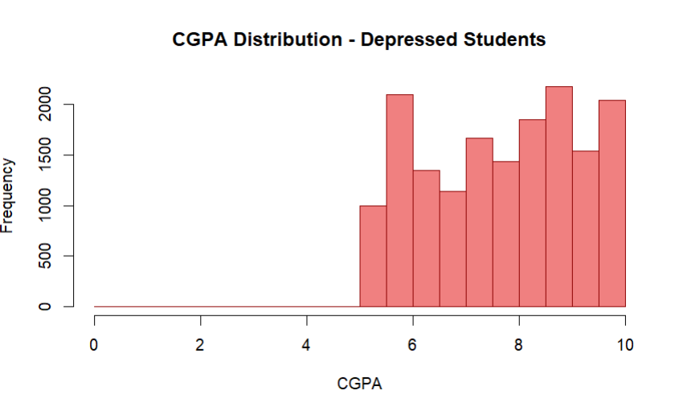
Here is a Histogram showing the frequencies of our dependent variable to include the normal curve overlay (shown in blue).
Our RQ asks about Differences in means/ medians
CGPA of Depressed Students
The normal curve overlay does not follow the shape of the underlying data, so we use the non-parametric test that does not assume normality: Wilcoxon also known as the Mann Whitney U Test.
8

Slide 9
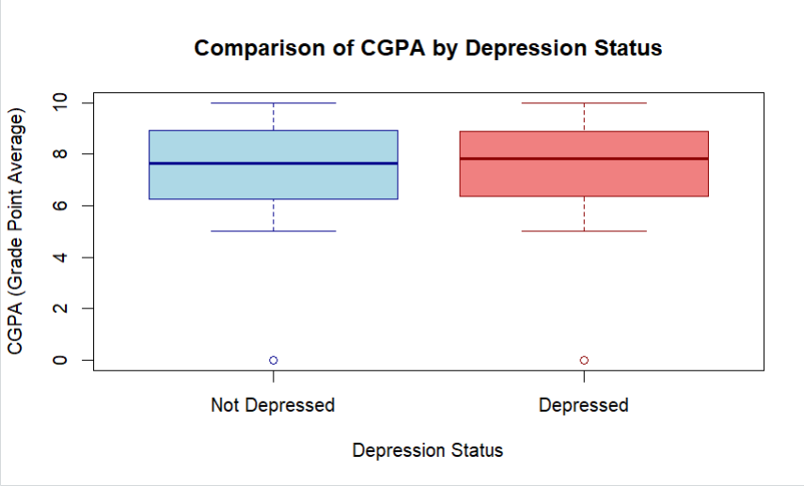
2. Boxplot

Slide 10
Part 2: Analysis

Slide 11
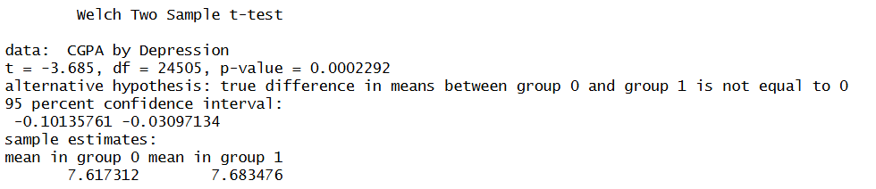
R Script and Results (T test for validation) – The Analysis
PRE 7COM1079-2022 Student Group No: ?????
11
# Independent T-Test – not required but used for validation
print("Independent t-test:")t_test_result <- t.test(CGPA ~ Depression, data = data_clean)
print(t_test_result)
Notes:
11

Slide 12
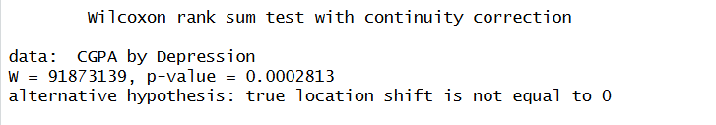
R Script and Results (Wilcoxon Test) – The Analysis
PRE 7COM1079-2022 Student Group No: ?????
12
# Wilcoxon Rank-Sum Test
print("Wilcoxon Rank-Sum Test:")wilcox_test_result <- wilcox.test(CGPA ~ Depression, data = data_clean)
print(wilcox_test_result)
Notes:
12

Slide 13
R Script and Results (Wilcoxon Test) – The Analysis
PRE 7COM1079-2022 Student Group No: ?????
13
p-value = 0.0002813 < 0.05 (The result is significant)
Null hypothesis (H0): There is no difference in the mean/median of the student academic score (CGPA) among depressed and non-depressed students in India. ​
​
Alt hypothesis (H1): There is a difference in the median CGPA between depressed and non-depressed students in India.​
Reject the null hypothesis
There IS a statistically significant difference in mean CGPA between depressed and non-depressed students in India.
Notes:
13

